Slide 1


Chapter 6
Storing data locally on a device for long-term use

Slide 2
Learning objectives
1. What is local storage
2. How to store and retrieve data locally on the device
3. How to validate a password
4. How to make sure that the user has accepted the disclaimer
5. How to accept and manage user profiles
6. How to store and manage an array of records

Slide 3
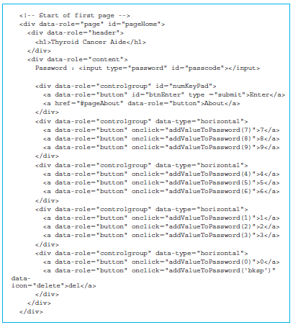
Managing numeric pad for password entry
JavaScript is used to manage the data in our Thyroid app.
We have an <input> element with the type “password” so text is not displayed, and its id is “passcode”.

Slide 4
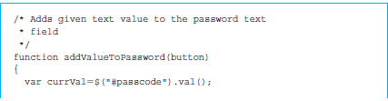
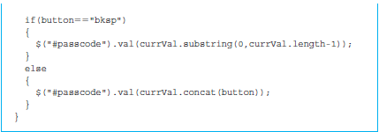
Managing numeric pad for password entry (cont’d)
The first line in the function retrieves the existing value of the <input> element passcode using the code $(“#passcode”).val().

Slide 5
Local storage
The localStorage object has a number of advantages
Storage
Fast
The data is never transferred to the web server.
Since the data is not included with every server request, it does not affect the website’s performance.
Secure
Since the data does not flow through the network, it is less likely to be exposed to the data sniffers.
A website can access only data stored by itself.

Slide 6
JSON objects for Thyroid app
Divide localStorage into three parts
agreedToLegal—the value will be true once the user has agreed to the disclaimer.
user—the value will be a JSON object with name/value pairs to store information about the user such as name, health insurance card number, and date of birth.
tbRecords—the value will be an array of JSON objects consisting of the historical values of various test results.

Slide 7
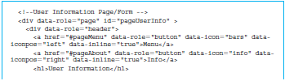
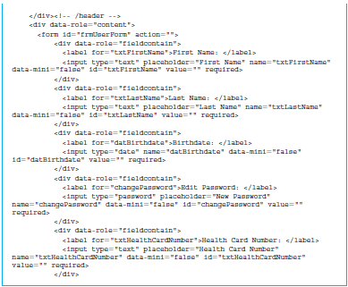
Managing JSON objects for user information
Data handling for managing information about the user that will be saved as an item in the localStorage with the storage key “user”.

Slide 8
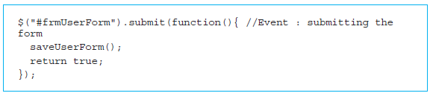
Managing JSON objects for user information (cont’d)
JavaScript code that will be executed when our form with the id “frmUserForm” is submitted is shown below.
$("#frmUserForm").submit()
saveUserForm()

Slide 9
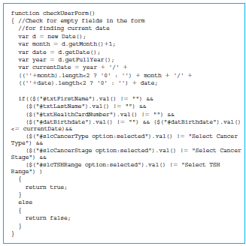
Managing JSON objects for user information (cont’d)
Date object
The conditional expression

Slide 10
Exception/error handling in JavaScript
Working with localStorage can result in errors.
May exceed available storage
Most object-oriented programming languages, including JavaScript, which can be object oriented, mandate that I/O operations involving disk are to be done in a try and catch block.
try{
// Code that does the disk operations
}
catch(variable)
{
// Code if the disk operations fail for any reason
}

Slide 11
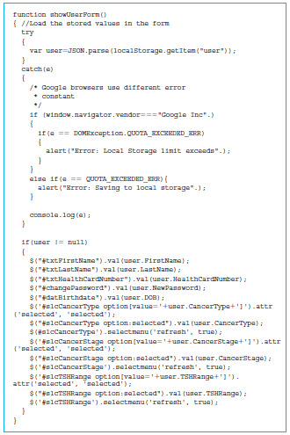
Displaying user information
The function showUserForm()
Starts with a try and catch block that is similar to the saveUserForm() function.

Slide 12
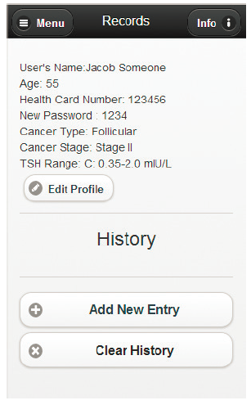
Screenshot of the Records page with no history in the Thyroid app

Slide 13
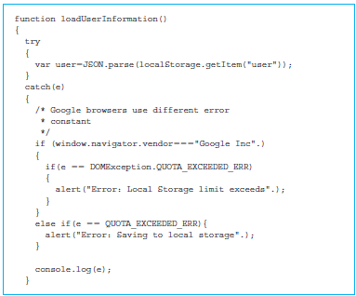
Managing the Records page
The page has a <div> section with the id “divUserSection” for displaying the user information.
Try and catch block retrieves the JSON object with the name “user” from the localStorage.

Slide 14
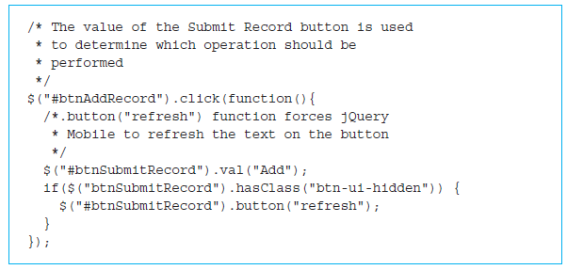
Adding a record
Records page has a button element with id “btnAddRecord”.

Slide 15
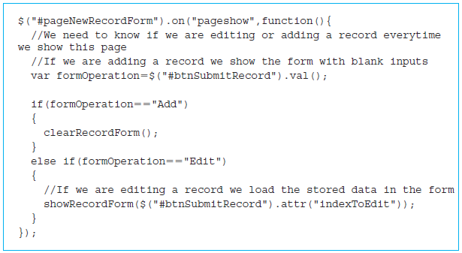
Adding a record (cont’d)
When the control is transferred to the page pageNewRecordForm, the following function is executed: $("#pageNewRecordForm")

Slide 16
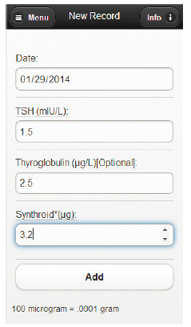
Screenshot of user adding a record of blood test

Slide 17
addRecord() function
The addRecord() function begins by checking to make sure all the values in the form are appropriate using the function checkRecordForm().

Slide 18
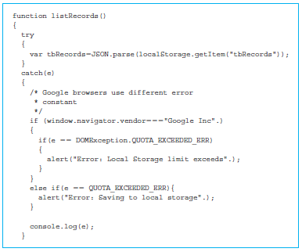
Displaying all the records/history
listRecords(): called after every operation to populate the history section on the Records page.
Try and catch block used to retrieve the item tbRecords from localStorage with the help of the localStorage.getItems() method.

Slide 19
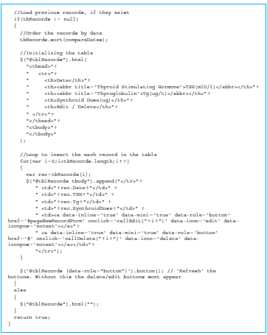
Displaying all the records/history (cont’d)

Slide 20
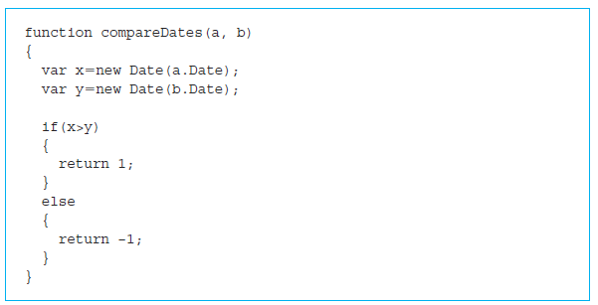
Displaying all the records/history (cont’d)
The function compareDates() is passed as parameter to the sort method—that is, tbRecords.sort(compareDates).

Slide 21
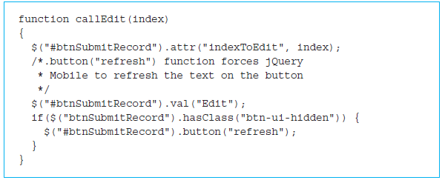
Editing a record
For editing a record we start with the callEdit().
Creates a new attribute called “indexToEdit” for the btnSubmitRecord element from the page pageNewRecordForm.
showRecordForm() opens a form containing all of the attributes from a given record and allows a user to edit and save those values.

Slide 22
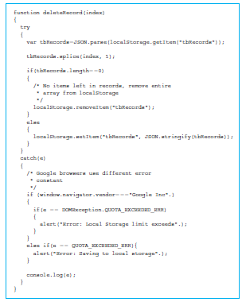
Deleting a record
The deletion of the record will be triggered after clicking on the delete button next to the record.

Slide 23
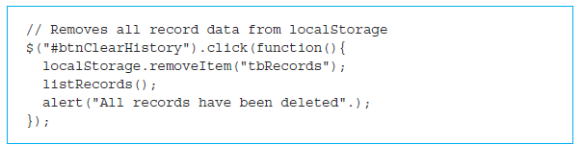
Deleting all the records/history
The very final record management function is deleting the history using the ‘Clear History’ button.
Clicking on the button will trigger the function:
$("#btnClearHistory").click(function(){...}

Slide 24
Quick facts/buzzwords
localStorage
localStorage.setItem()
localStorage.getItem()
JSON
JSON.parse()
JSON.stringify()
exception handling using try/catch
QUOTA _EXCEEDED_ERROR
Date object
Anonymous JavaScript functions
click()
attr()

Slide 25
Quick facts/buzzwords (cont’d)
submit()
html()
append()
splice()
button(‘refresh’)
$.mobile.changePage()

